Slide 1
Submitter: Justin Rodriquez
JIRA project: MCLS- 3435
Request: EDS quantification & diffraction pattern analysis
Report Date: Oct. 4, 2021
Prepared by: Jennifer Gray, Ph.D.
N022 Millennium Science Complex
jlg375@psu.edu
814-865-2371
Co-author information for publications: Jennifer L. Gray, Materials Research Institute, The Pennsylvania State University, University Park, Pennsylvania 16802, United States

Slide 2
Methods:
TEM and STEM done in Talos TEM at 200 kV.
EDS mapping done to look at composition of layer.
HAADF-STEM – high angle annular dark field – better mass contrast than TEM. Contrast approximately proportional to Z². Contrast is reversed as compared to TEM.
Diffraction pattern analysis done in JEMS

Slide 3
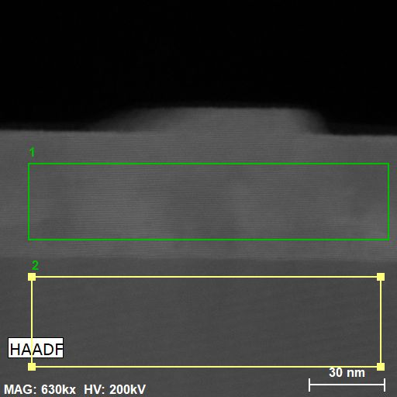
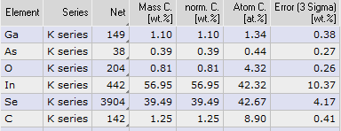
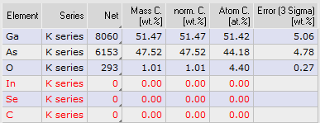
Results: quantification
Quantification of InSe layer
Ga will be present everywhere due to Ga source in FIB sample prep. The As % within InSe layer is not above background noise.

Slide 4
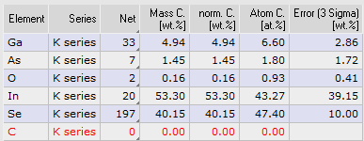
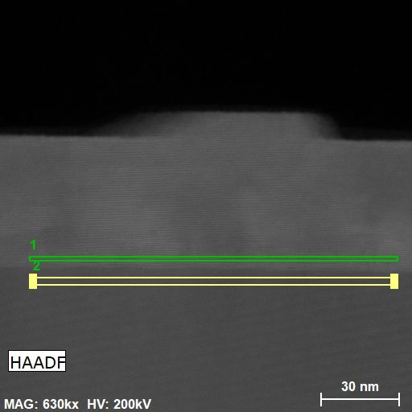
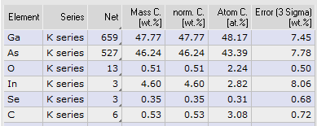
Results: quantification near interface
As not above detection limit in InSe layer
In, Se not above detection limit in GaAs layer (3 sigma number)

Slide 5
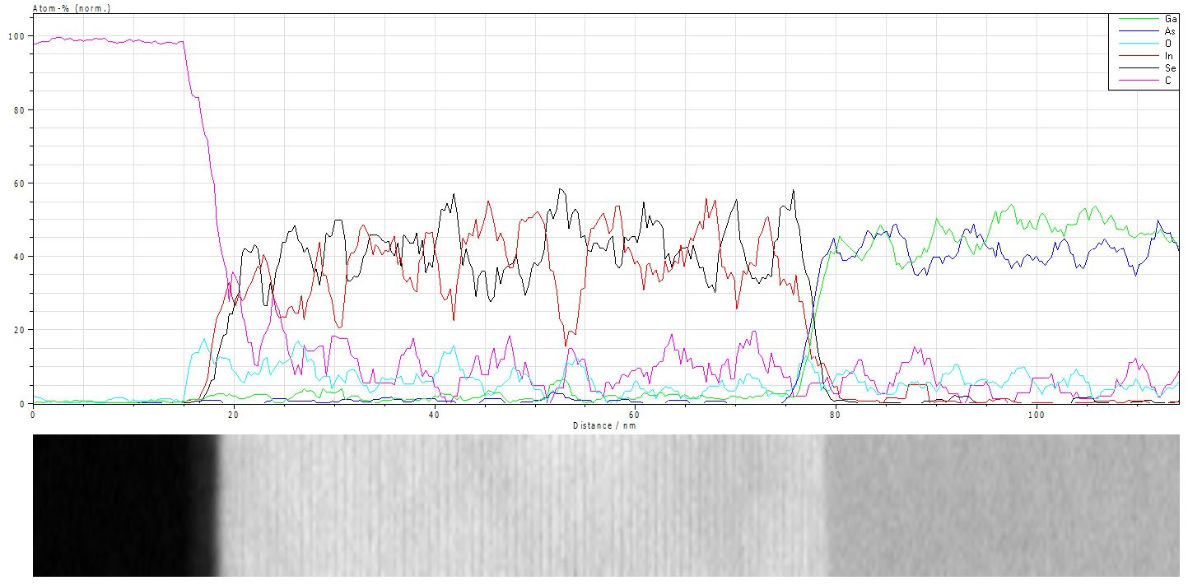
Results: STEM –EDS quantified linescan:

Slide 6
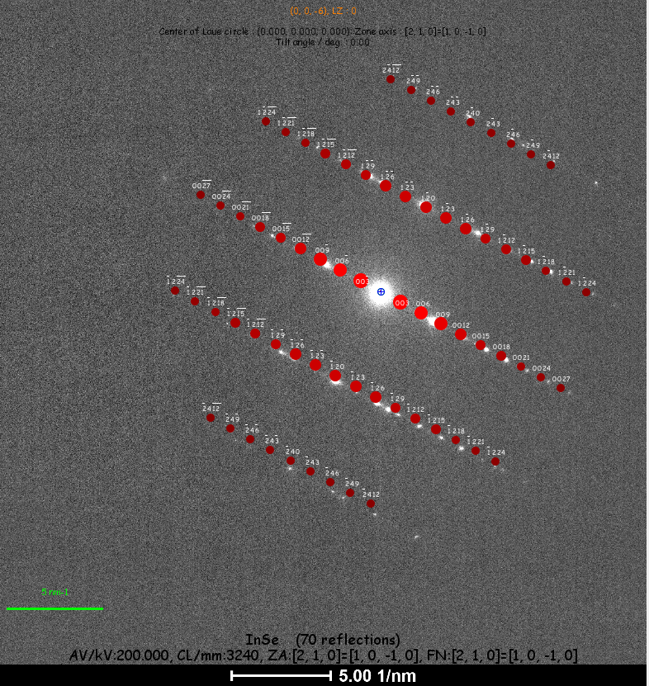
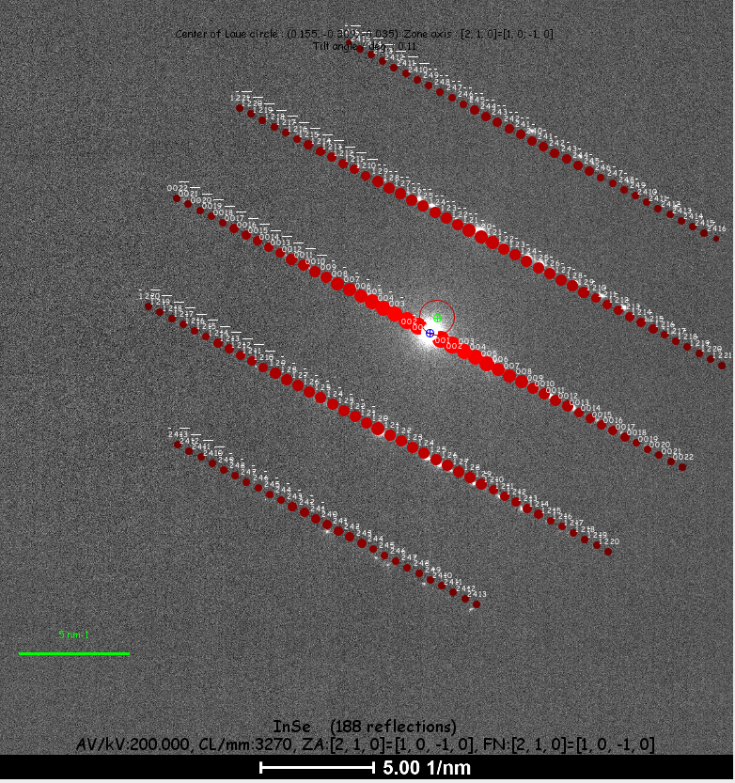
Results: diffraction pattern: good match for [210] zone axis of R3H structure. P63/mmc may have too many spots.

